Slide 1
The Message Breakpoint Method
to find Critical Function

Slide 2
The challenges to setting breakpoints
In the classic Handle-Proc algorithm we click button to insert input str into memory, then we pause the
debugger to look for the memory, and then put HWBP on it and click button again assuming that it will re-use
the same memory address to store the input string.
But, some programs store the input string in different memory addresses each time the button is clicked.
Therefore, the HWBP won’t hit.

Slide 3
Handles-Proc Algorithm
To Pause Debugger
To Search Memory for Input Str
To Search Which Instruction Access the Input Str
To Search Which Function Processes the Input Str

Slide 4
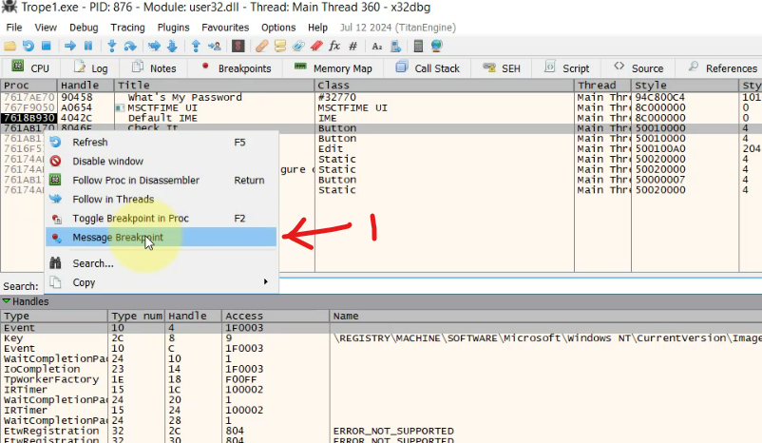
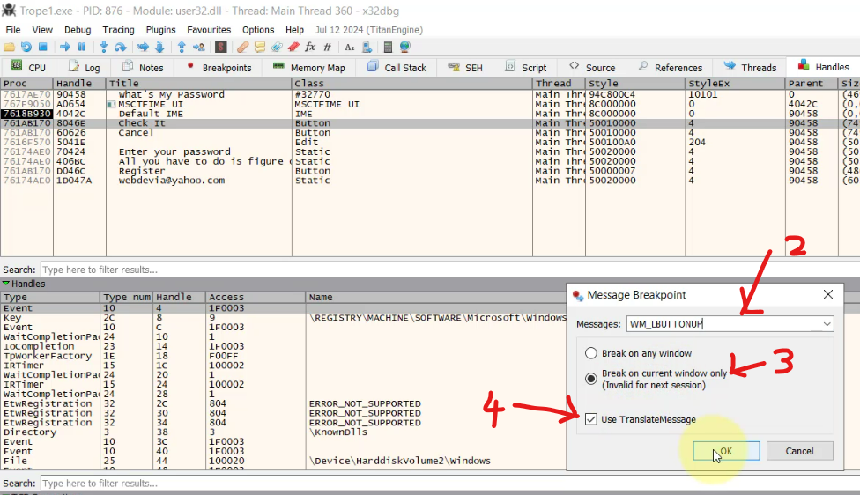
Message BP Method to Find Critical Function
To Pause Debugger with
Message Breakpoint
To Search Which Function
Processes the Input Str
Set Message BP
(2,3,4) Set Parameters

Slide 5
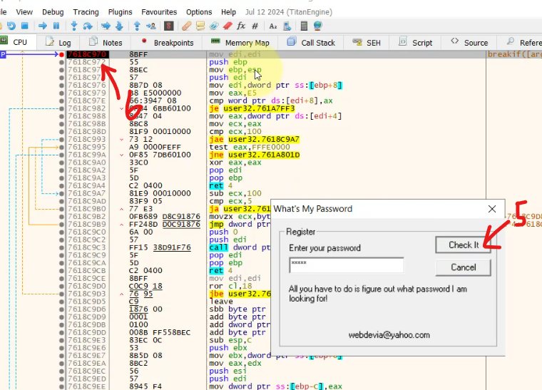
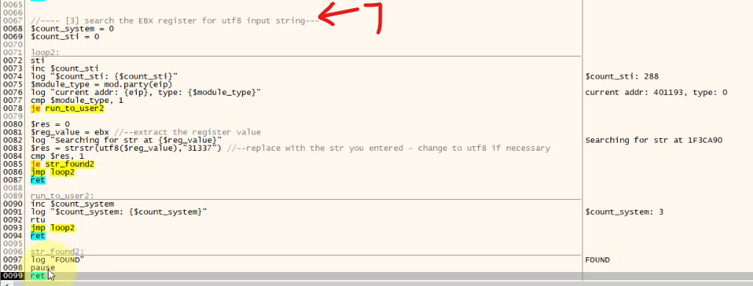
(5) Click button
(6) It hits BP
(7) Run Register Search Script

Slide 6
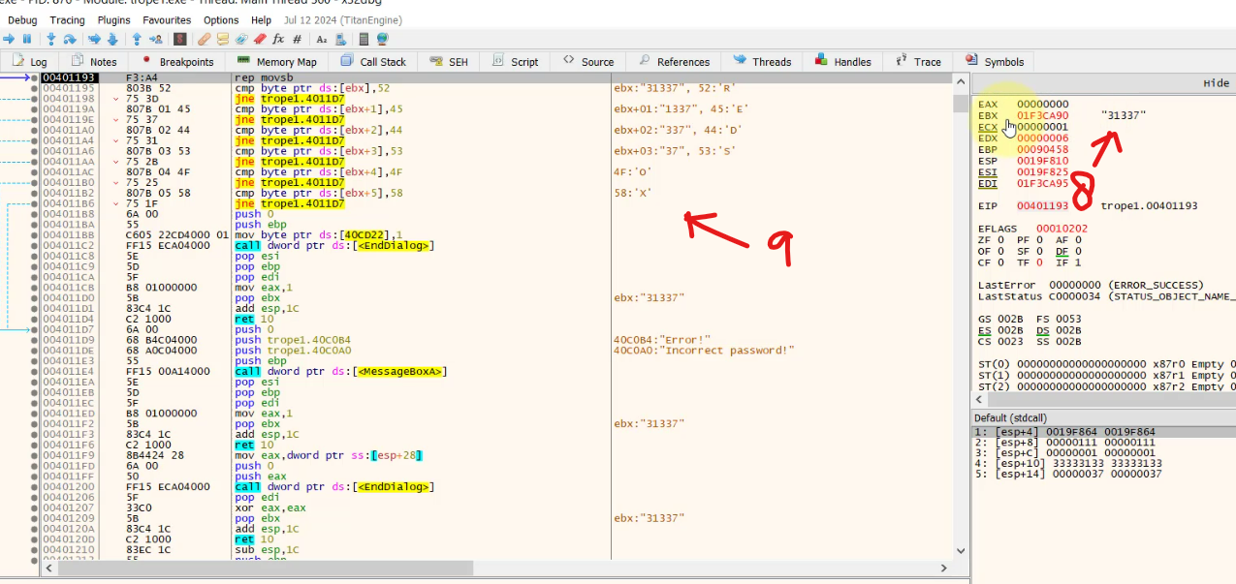
(8) Found Input String
(9) Found Critical Section

